Slide 2
Permaculture Design and practical application in a Namibian context
by Donovan Wagner
Eloolo Permaculture Initiative

Slide 3
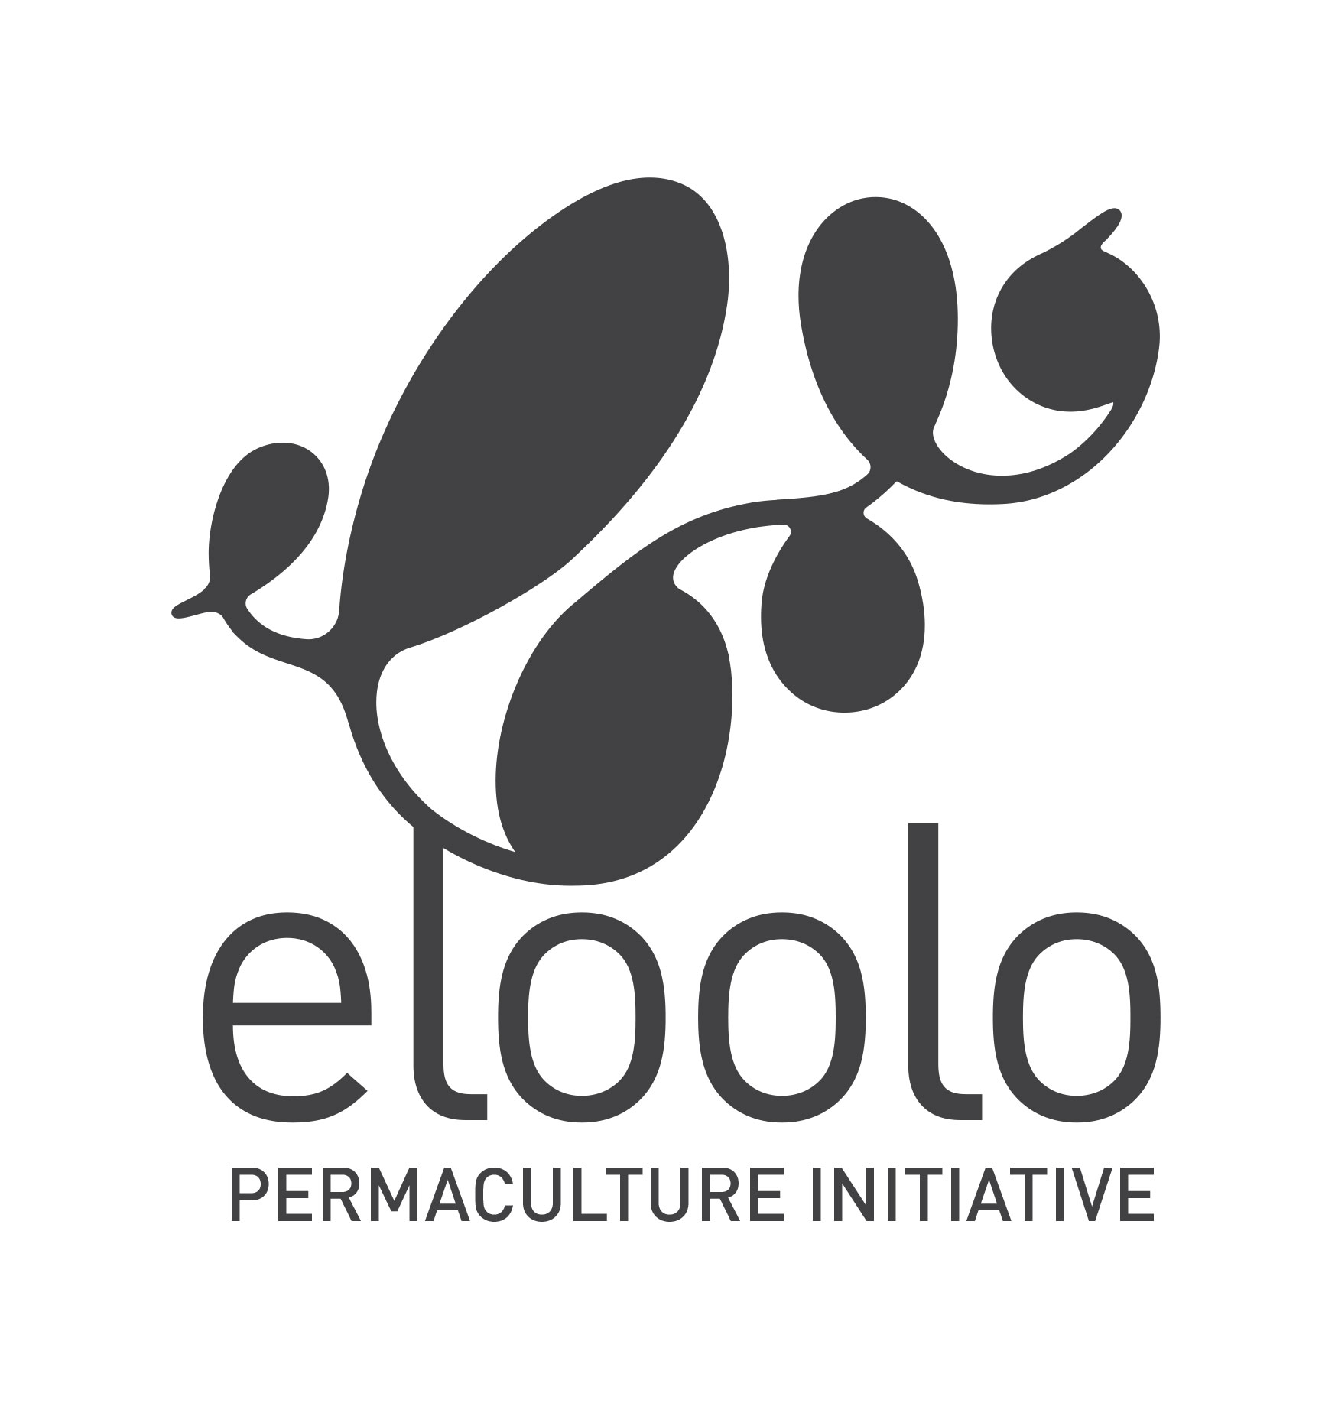
Oshivambo for ‘abundance’
Why ‘Eloolo’?!
We believe that even though faced with the effects of the current climate crises, Namibians can transform their environment into a resilient and abundant human eco-system that provides for all our needs!

Slide 5
Permaculture in Namibia: Eloolo and others
Namibian NGO since end 2017
Projects incl.: School garden, Farm Okukuna, Clean Travel (tree planting), lodge garden in Zambezi, ToT of Shack Dwellers Association of Namibia members and training and consultation for conservancy village gardens
Others: Dr Ibo Zimmermann/NUST and many others who have completed the Permaculture Design Certificate (PDC) or who are self-taught are using this knowledge and applying it on their farms, homes, work or elsewhere
2015 NOA ran Namibia’s first and only full PDC near Okahandja
More and more people and organizations are looking into Permaculture for guidance as it becomes apparent that we need to look at the world and environment around us as a whole, a system that is inter-connected and dependent on all its individual parts.

Slide 6
One-million-dollar question: What is Permaculture?
History & beginnings:
70s Australia, Bill Mollison & David Holgrem
Design philosophy
Systems thinking
3 ethical and 12 design principles
With nature and not against
Providing all human needs
DEFINITION (one of many!):
Permaculture is the conscious design and maintenance of agriculturally productive systems which have the diversity, stability, and resilience of natural ecosystems.
It is the harmonious integration of the landscape with people providing their food, energy, shelter and other material and non-material needs in a sustainable way.

Slide 7
Ethical and design principles

Slide 8
Permaculture design - basics
Input & output
Each element 3 functions – making connections, building synergies!
No waste/cycling
Design considerations:
Elements (sun/wind/fire/security)
Slope
Aspect
Access
Existing structures and future plans

Slide 11
Permaculture - Namibia: practical context
Design - the more detail the better!
Appropriate methods and technologies: drylands
Energy: solar, appropriate technology eg rocket stoves
Water: catch and store; slow, spread, sink, appropriate tech: eg dry toilets
Earthworks (small/big): swales, dams, erosion control, …
Watering conservation eg mulch, watering: drip or planning
Soil - nitrogen fixers and guilds, organic content and soil life eg compost, EMs, BioChar etc.
Microclimate: Hedges, living fences to keep out dry and strong winds and protect from frost. Trees keep it cool and moist in summer.
TREES! Trees! Trees!

Slide 14
Experiences & feedback from projects
Most partners do not have sufficient understanding of what exactly Permaculture is
Permaculture is often seen of an organic way of growing food BUT we start looking at food as an integrated part of our environment and life.
Planning period too short/projects and partners do not have the time
Design has become a more simplified process
Local/traditional knowledge must be appreciated and integrated
Keep it simple, start small, work with what you have eg materials/upcycle
More follow up needed/would be great!

Slide 16
Shack before…

Slide 17
…and after/with Permaculture

Slide 19
The way forward
Networking and info sharing - already starting to happen across platforms
Partnerships, locally and internationally
R&D - local hubs eg NE, central, coast, south
Knowledge transfer - students, schools, farmers and communities etc
Capacity building - organizational

